Slide 1
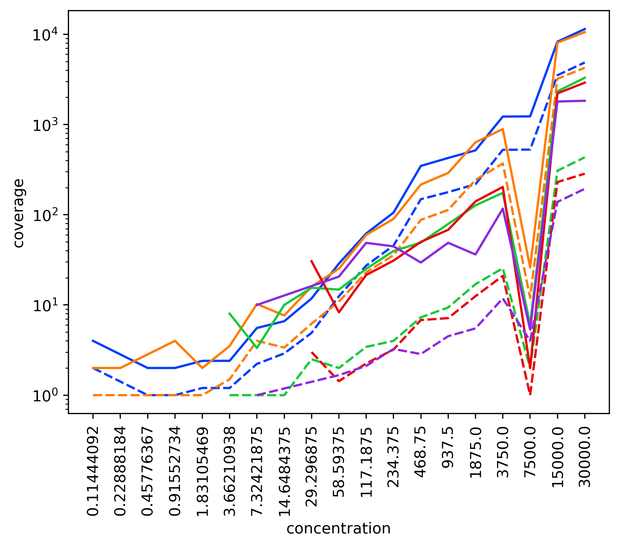
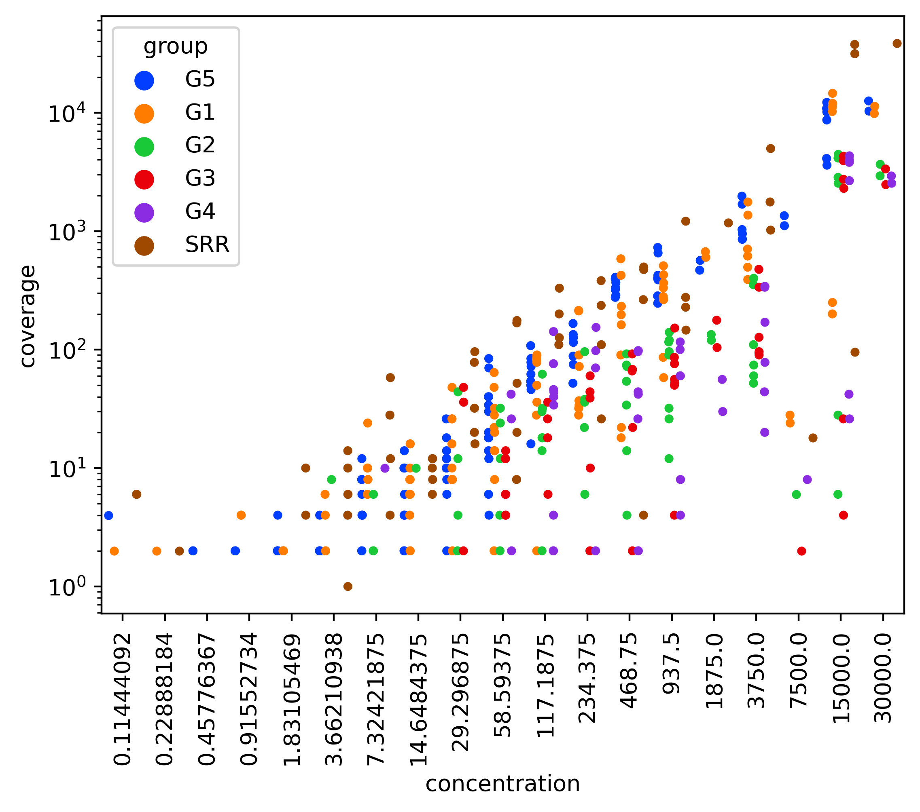
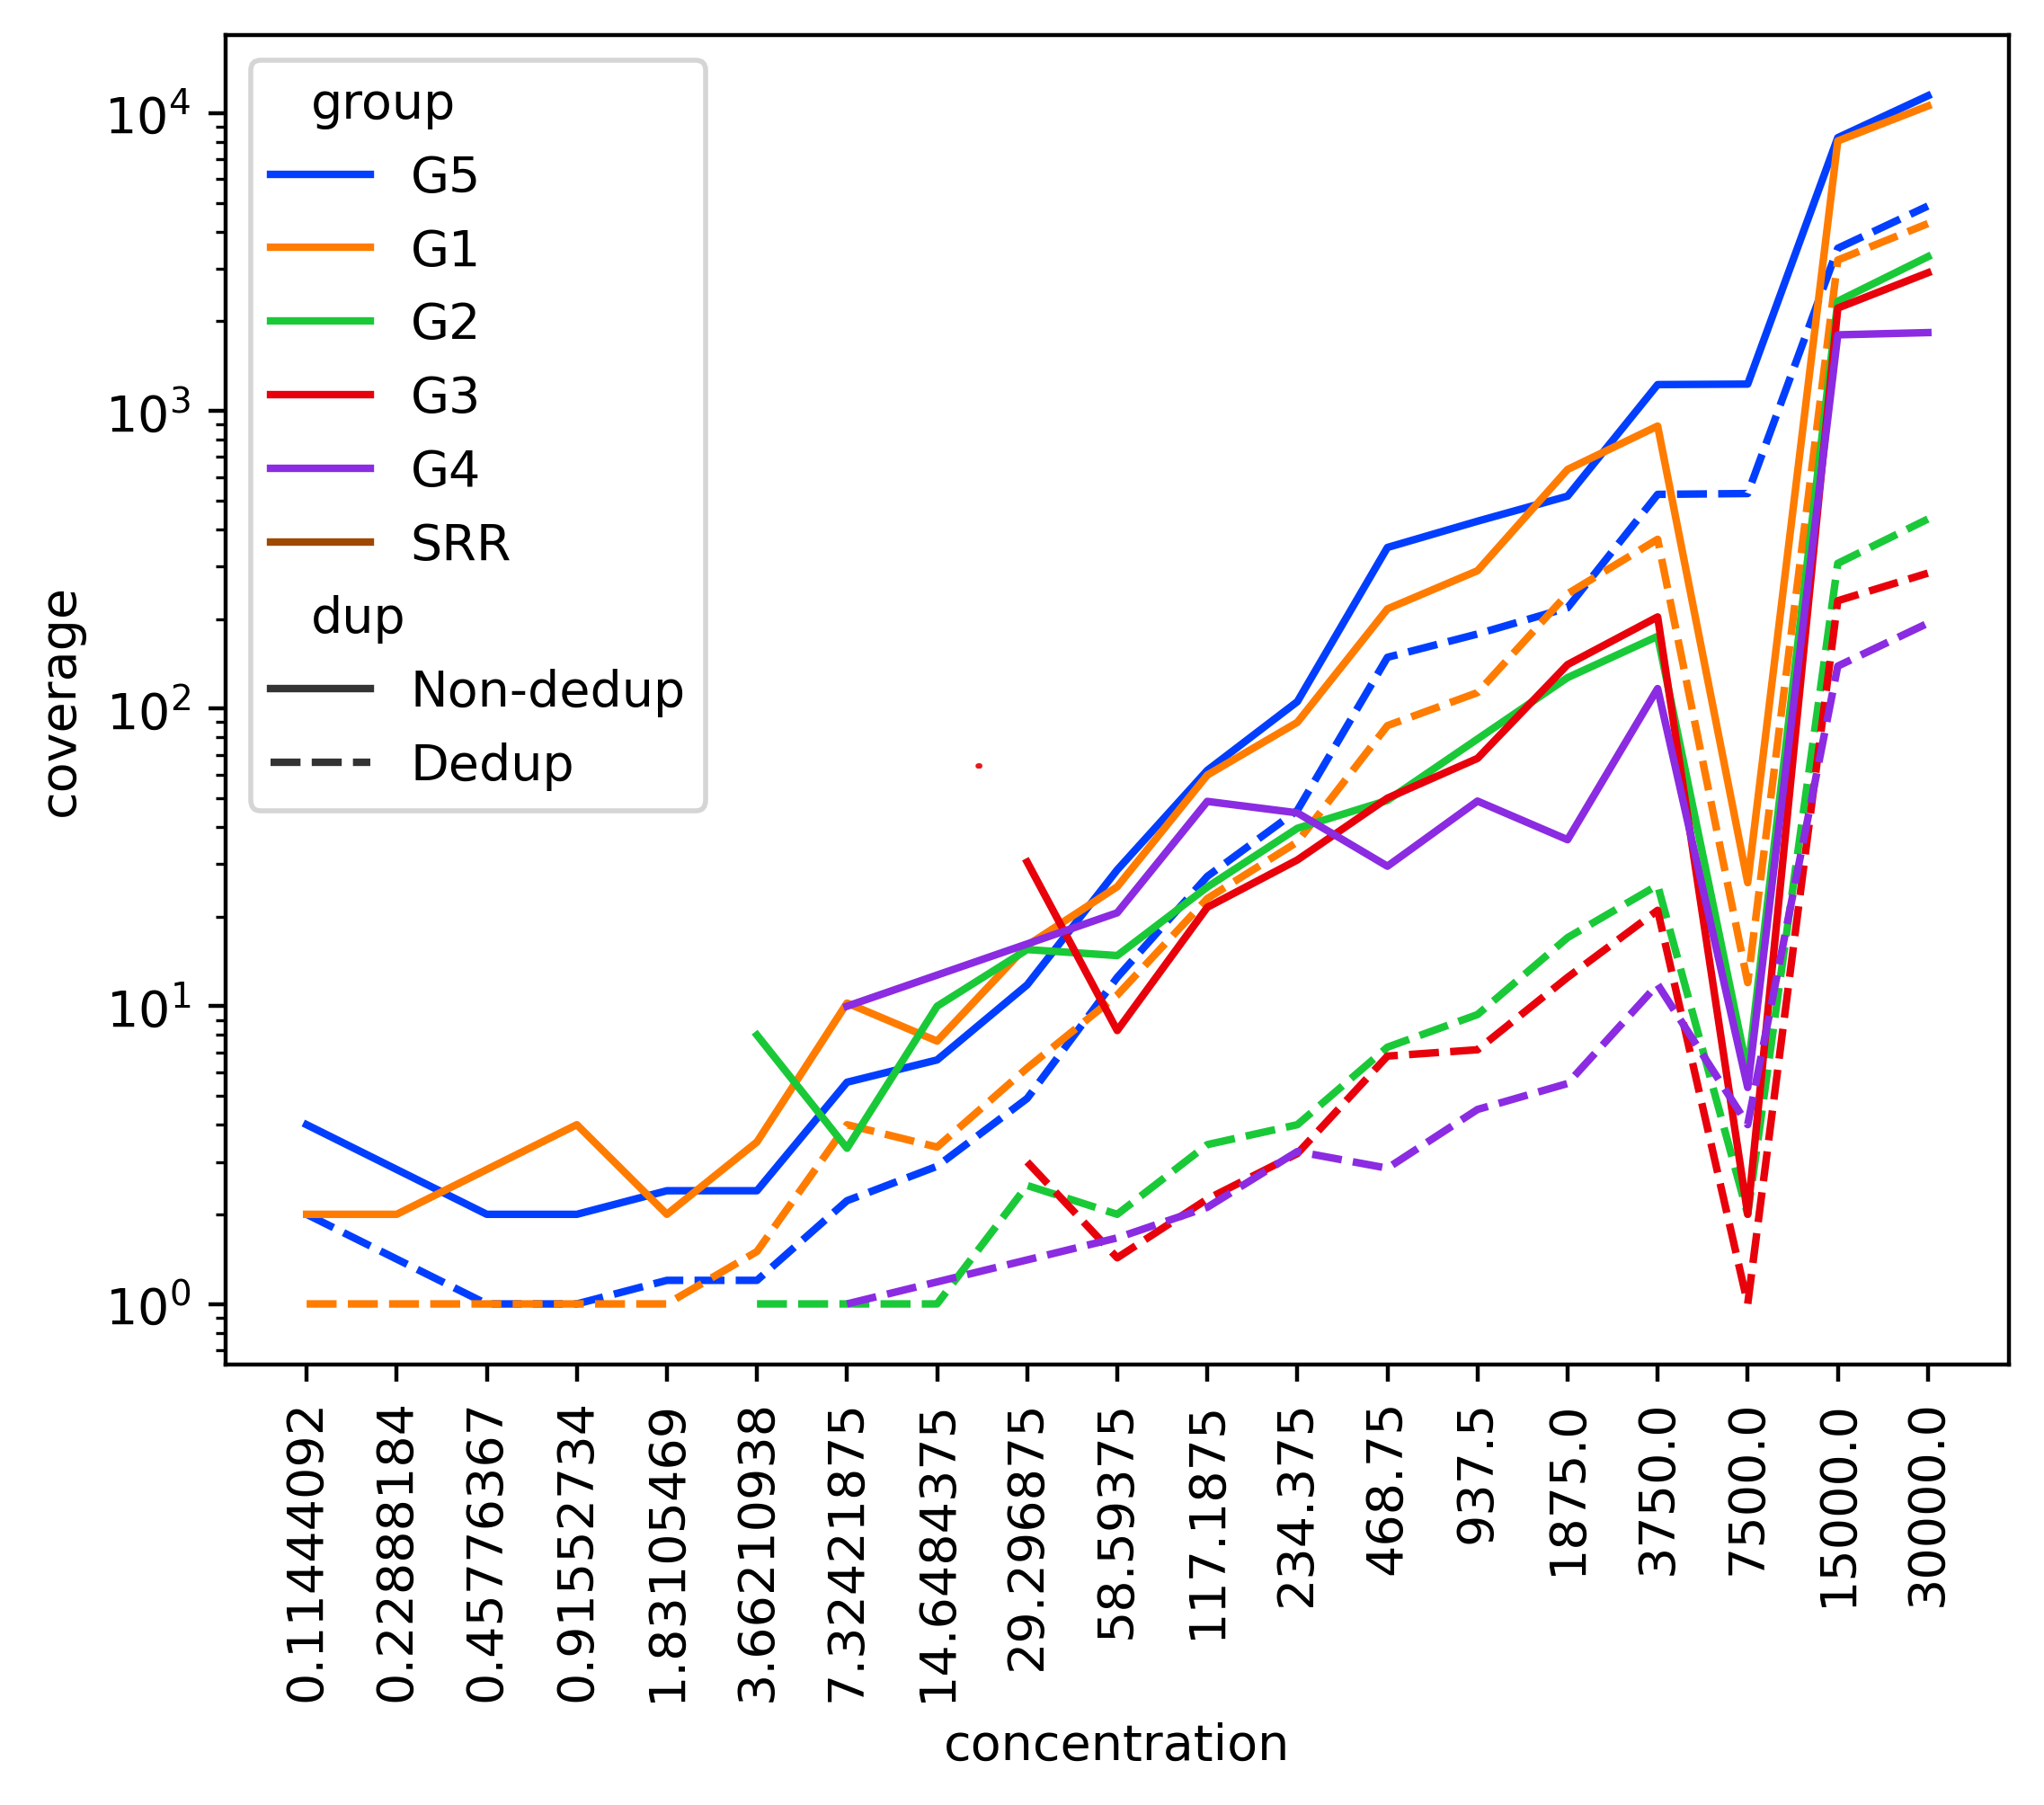
A
10⁴
10³
10²
10¹
10⁰
RNAseq
MT-A
MT-B
MT-C
MT-D
ERCC read coverage
Concentration (attomoles/ul)
Notes:
(A) ERCC coverage compared to input ERCC concentration in non-UMI-deduplicated libraries and their corresponding deduplicated libraries. Reads were mapped using meRanGh. The concentrations were prepared according to the ThermoFisher protocol (Methods). Each concentration listed contains multiple unique ERCCs.

Slide 2
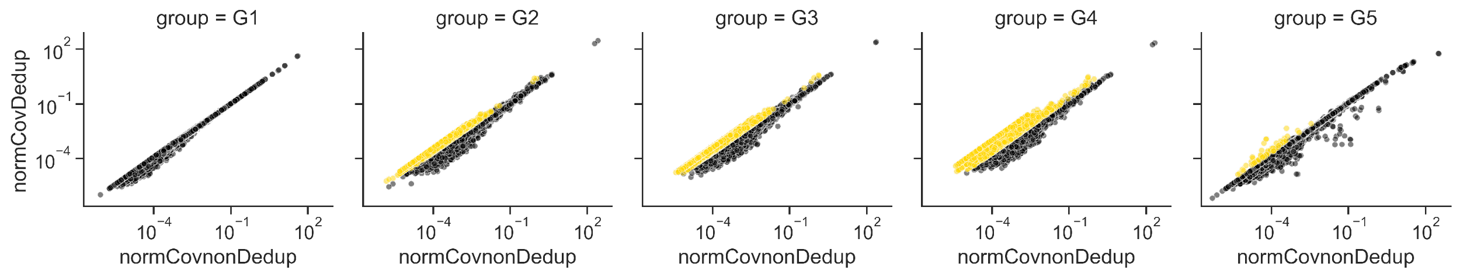
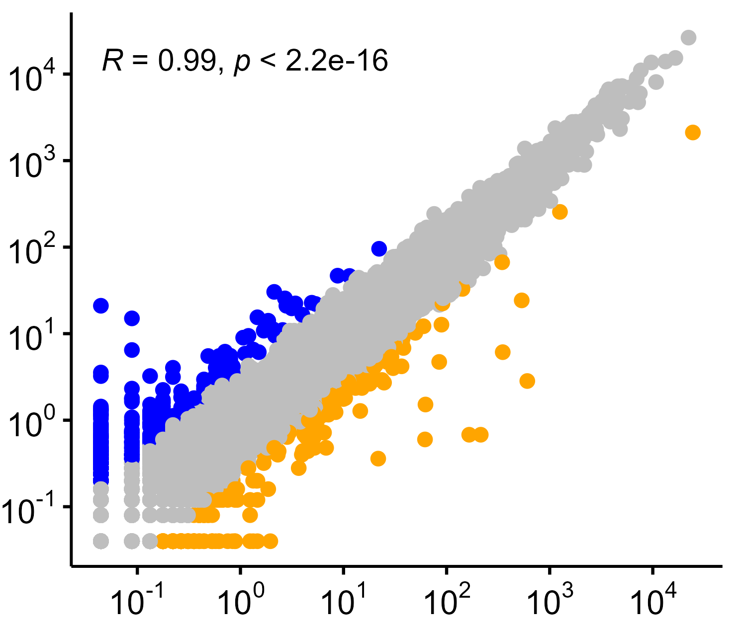
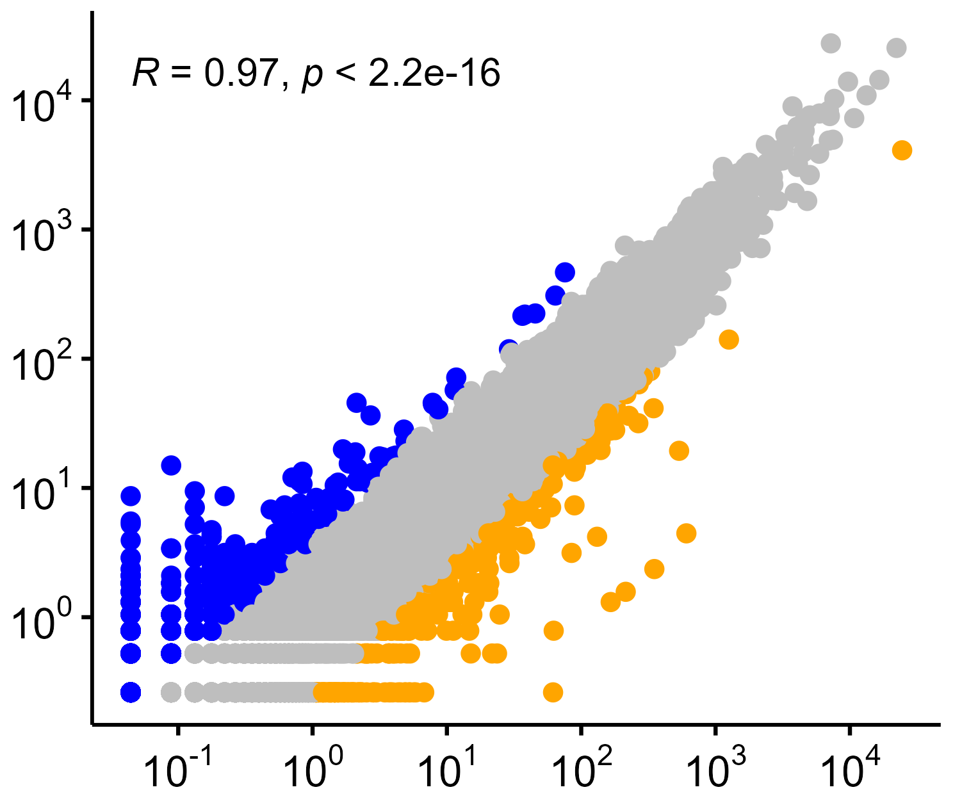
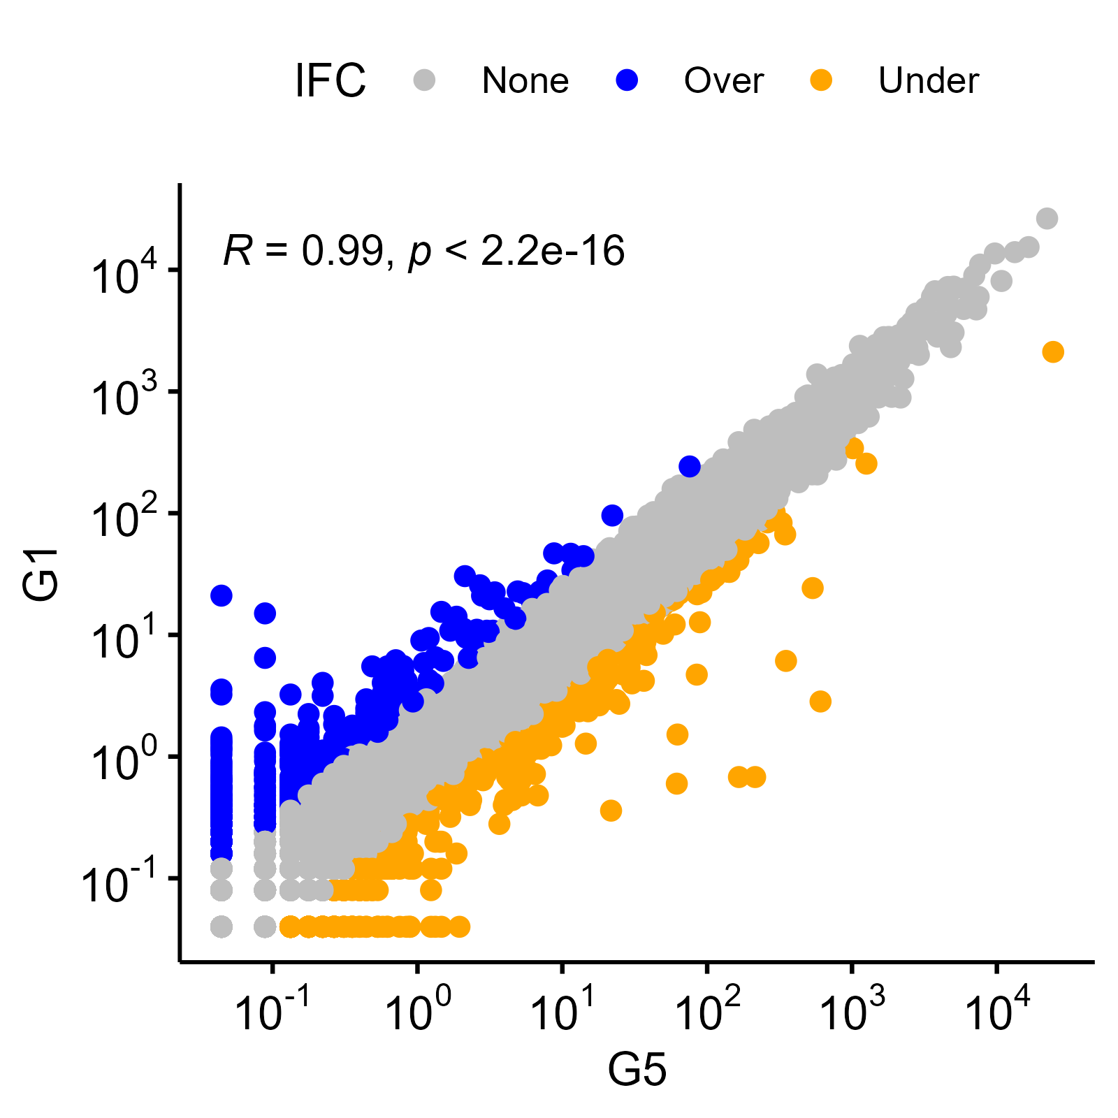
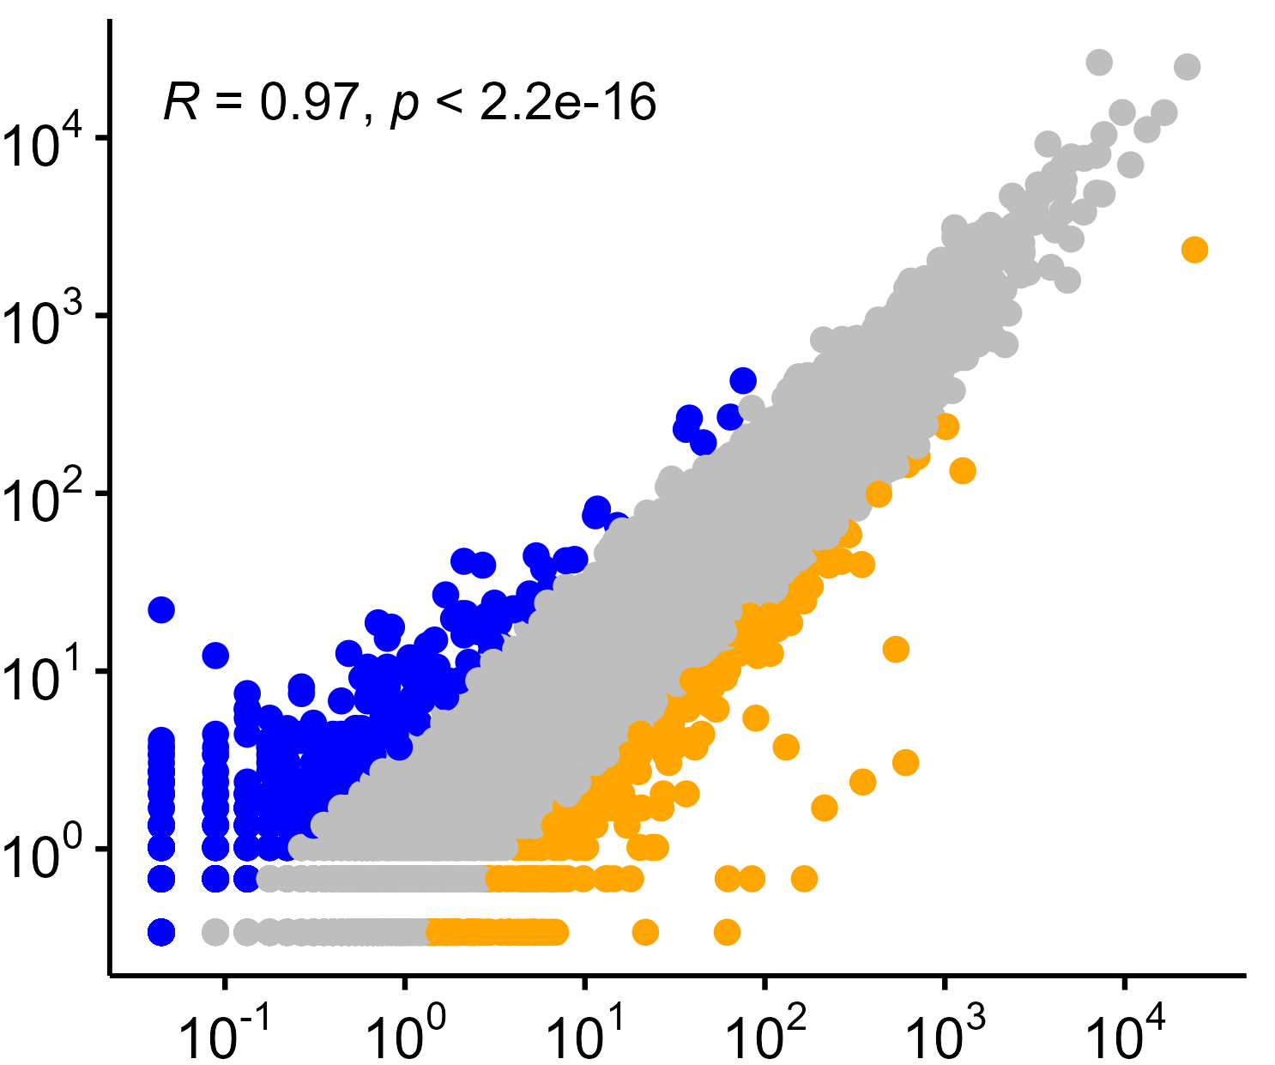
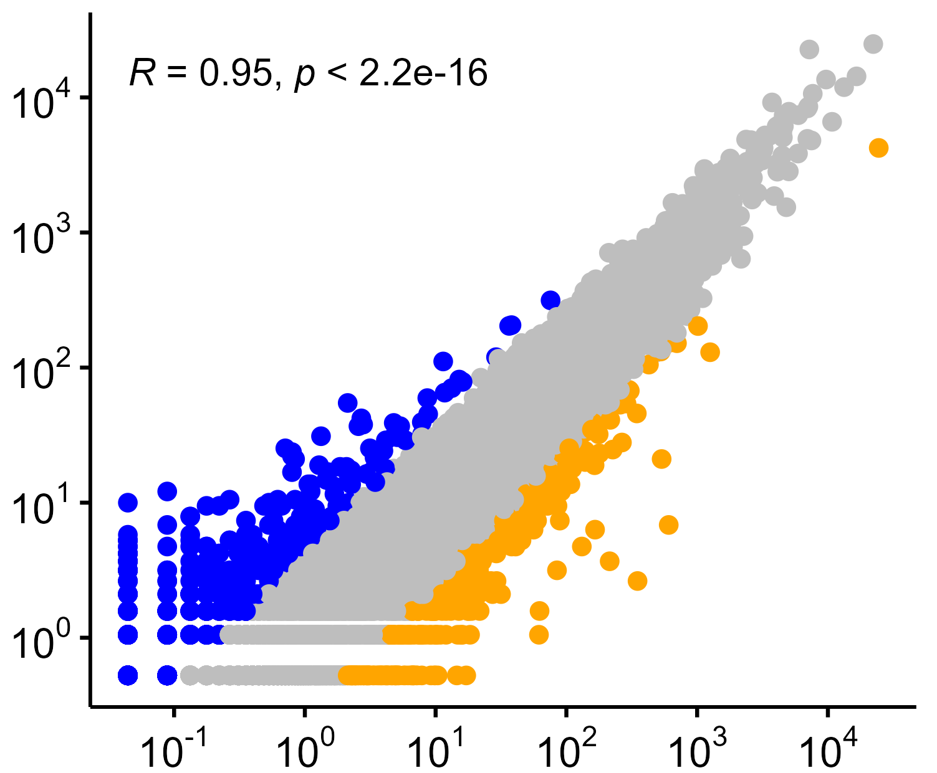
B
MT RNAseq
MT-A
MT-B
MT-C
MT-D
10⁴
10²
10⁰
n = 18,392 LFC > 2: n = 27
n = 18,793 LFC > 2: n = 0
n = 15,442 LFC > 2: n = 1,471
n = 14,633 LFC > 2: n = 1,647
n = 14,648 n > two-fold change: 1,802
Deduplicated CPM
10⁰ | 10² | 10⁴
10⁰ | 10² | 10⁴
10⁰ | 10² | 10⁴
10⁰ | 10² | 10⁴
10⁰ | 10² | 10⁴
Non-deduplicated CPM
C
MT-A
MT-B
LFC > 2
LFC < 2
Counts per Million
MT-C
MT-D
Counts per Million (RNAseq)
Notes:
B) Counts per million values of deduplicated and non-deduplicated libraries were calculated from meRanGh mapped files using featureCounts. Genes which experienced more than two-fold log-fold change are highlighted in yellow. C) CPM values of bisulfite libraries were compared to non-converted RNAseq libraries. Genes with higher than two-fold change are highlighted in blue, which genes with less than two-fold change are highlighted in green.

